Slide 1
FY21 PROJECTED PROFITABILITY ANALYSIS
LOYOLA UNIVERSITY, NEW ORLEANS

Slide 2
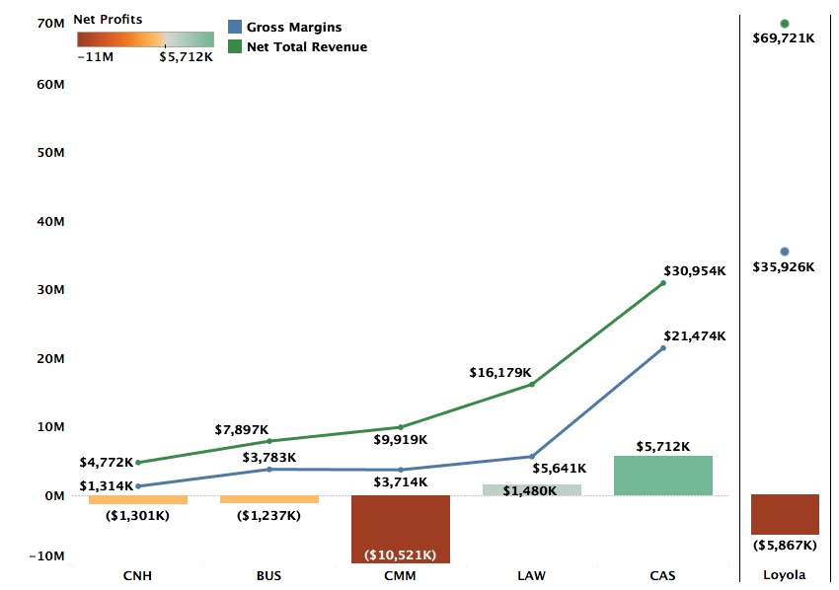
Profitability by College FY21 Projections

Slide 3
Profitability by Department (FY21 Projections)
Excluding Environment
Notes:
Accounting is projected to be positive. All other 14 departments continue to be loss making. – Add the note on Accounting

Slide 4
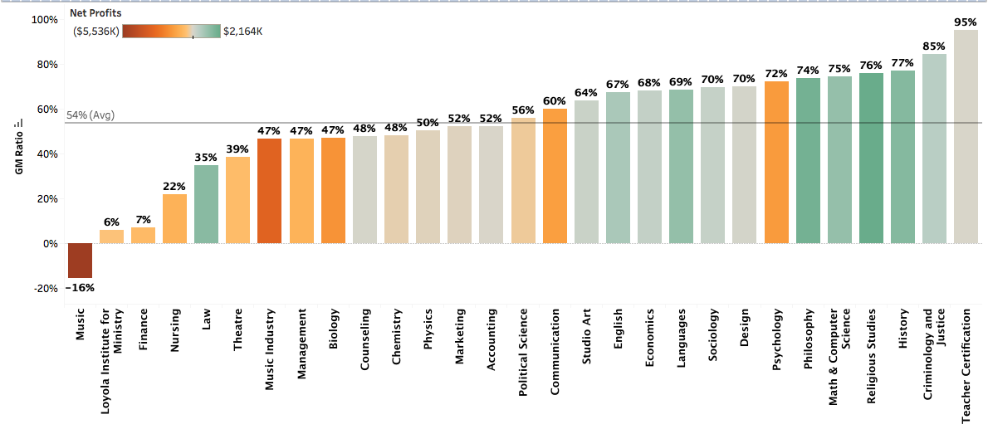
GM to Revenue Ratio by Department (FY21 Projected)
Excluding Environment

Slide 5
DEFINITIONS
Net Total Revenue (NTR): NTR includes revenue for courses taught by the faculty of a department across all three terms, distributed revenue for courses that do not belong to a specific department, and distribution of revenues from courses of programs like Study Abroad that do not have any assigned faculty. Projected Avg. NTR per department = $2.2m
Gross Margins (GM): GM = NTR – Direct Costs. Direct costs include salaries, operating costs, and fringe benefits. Projected Avg. GM/NTR for FY21 = 54%
Profitability = GM – Indirect Costs + Indirect Revenues. Indirect costs refer to administration costs, auxiliary costs, or college level costs distributed over departments of the specific college. Indirect revenues include auxiliary revenues, dorm revenues, and revenue from other sources.

Slide 6
Methodology FY21 Projections
FY21 Revenue Projections: Revenue projections are based on Fall 2020 enrollments and projected Spring retention rate. FY20 summer revenues are used as proxy for the FY21 summer term.
Direct Costs: Direct costs include salaries and operating costs from department budgets. FY20 fringe benefits are used as a proxy for FY21 fringe benefits.
Indirect Costs: Indirect costs in FY20 and FY21 have been higher than previous years and is reflected in department-level profitability. FY21 is also estimated to bring in lower Auxiliary revenues.

Slide 7
DEPARTMENTS WITH WORSENING FINANCIAL PERFORMANCE

Slide 8
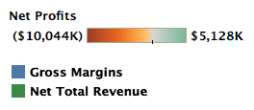
Music
GM for Music slipped into negative in FY20 and is projected to continue being negative in FY21. At -16%, the GM to Revenue ratio of Music is the lowest among all departments.
Music has high enrollment but also high discount rate which is driving the low GM that are not enough to cover either the direct costs or the overhead costs for the department
Music also has more than twice the directs costs of an average department at the university

Slide 9
Music Industry
NTR and GM for Music Industry are projected to continue to decline in FY21 because of combination of lower enrollment and higher discount rates
The projected avg GM to Revenue ratio for Music Industry is 47% compared to the university average of 54%
Increased auxiliary costs and reduced auxiliary revenues because of COVID-19 add to the losses but the structural issues that have driven losses historically persist

Slide 10
Nursing
Nursing’s losses are driven primarily by lower enrollment in FY21 and continuously high direct costs.
The declining trend in NTR is projected to continue for Nursing because of lower enrollment in FY21.
At 22% GM to Revenue Ratio, Nursing also has high direct costs and continues to be an expensive program. Direct costs of ~$2.2M is more than double the average direct costs of ~$1.1M.

Slide 11
Theatre
The projected GM to Revenue Ratio for Theatre is 39%, 15 percentage points lower than the university average.
Theatre’s low GM is being driven high discount rates and high direct costs
Projected increases in auxiliary costs and simultaneously declining auxiliary revenues because of COVID-19 add to the department’s losses

Slide 12
Psychology
Psychology’s losses are driven largely by high discount rates. As such, given the size of the department in terms of enrollment, the NTR is less than proportionate to the size.
The GM to Revenue Ratio of 72% compared to the university average of 56% is down to low direct costs.

Slide 13
Biology
Compared to the university average of 54%, Biology’s GM to Revenue Ratio is 47%, driven by high discount rates.
With almost constant NTR and GM from FY20 to FY21, the increase in projected losses for FY21 are driven by higher auxiliary costs and lower auxiliary revenues.
However, the structural problems of high discount rates from FY19 remain as the GM fails to cover the overhead.

Slide 14
Communication
Communication had an increase of ~33% in NTR from FY19 to FY20 but is projected for a decline of ~7% in FY21 because of lower enrollment and high discount rate.
Its GM to Revenue Ratio of 60% is higher than the average of 54%.
However, that is not enough to cover the high auxiliary and student specific indirect costs given the size of enrollment in the department.

Slide 15
DEPARTMENTS WITH IMPROVING FINANCIAL PERFORMANCE

Slide 16
Chemistry
After a drop in GM in FY20, Chemistry is projected to improve GM in FY21 because of better enrolment and lower direct costs.
GM to Revenue Ratio for Chemistry is projected to improve from 35% (FY20) to 48% (FY21) thereby reducing losses.
However, structural issues pertaining to high discount rates pertain for the department.

Slide 17
Political Science
The GM to Revenue Ratio has improved from 50%(FY20) to 56%(FY21) driven mainly by higher revenues because of higher enrollment as direct costs have stayed largely constant.
Structural issues with high discount rates remain. Lower discount rates will help the department pull in revenue proportionate with its size in terms of enrollment.

Slide 18
Management
Management’s NTR has not changed much from FY19 through the projected FY21 with changes in losses driven mainly by the department’s share of auxiliary and student specific indirect costs
Management suffers from the common structural issue of high discount rate and currently does not pull proportionate revenue given that the department is nearly twice the size of an average department.

Slide 19
Marketing
Healthy projected increase in NTR for Marketing is likely to reduce the losses for the department to $60K. This is driven by higher enrollment.
High discount rates remain a structural problem that prevents the GM to cover the department’s share of auxiliary and student specific indirect costs.

Slide 20
Finance
Finance had a steep decline in NTR in FY20 leading to a big drop in GM to Revenue Ratio from 39%(FY19) to 7%(FY21).
This is a consequence of lower enrollment in FY20 and FY21 and higher discount rates that lead to disproportionately lower NTR.
Finance’s share of indirect costs and direct cost is small given the size of the department. So, the department needs to be pulling in more revenues by improving enrollment and reducing discount rate.

Slide 21
Loyola Institute for Ministry
Compared to the university average of 54%, the FY21 projected GM to Revenue Ratio for LIM is 6%. This is driven primarily by high discount rates and higher than proportionate direct costs.
Given the small size of the department in terms of enrollment, its share of indirect costs is minimal. So reducing direct costs and increasing enrollment at lower discount rates is key to profitability.

Slide 22
Summary and Recommendations
Higher indirect costs and lower auxiliary revenues because of coronavirus crisis are reflected in losses of all departments.
Outside of the increased auxiliary costs, loss-making departments suffer from performance issues of lower enrollment and structural issues of high direct costs and high discount rates
High discount rates reflect the discounts offered to students taking courses offered by specific departments. These students may or may not be part of the majors offered by the departments. As such, driving lower discount rates should be a university wide initiative.

Slide 23
Summary and Recommendations
For departments with reducing enrollment, a separate analysis to identify the majors driving lower enrollment can be provided at a later date.
Additional analysis that can benchmark proportionate direct costs in relation to enrollment in each department can help improve the GM to Revenue Ratio.
Finally, improvement in auxiliary revenues and reduction in auxiliary costs post-coronavirus will aid the university-wide profitability.

Slide 24
Appendix (FY19 and FY20)

Slide 25
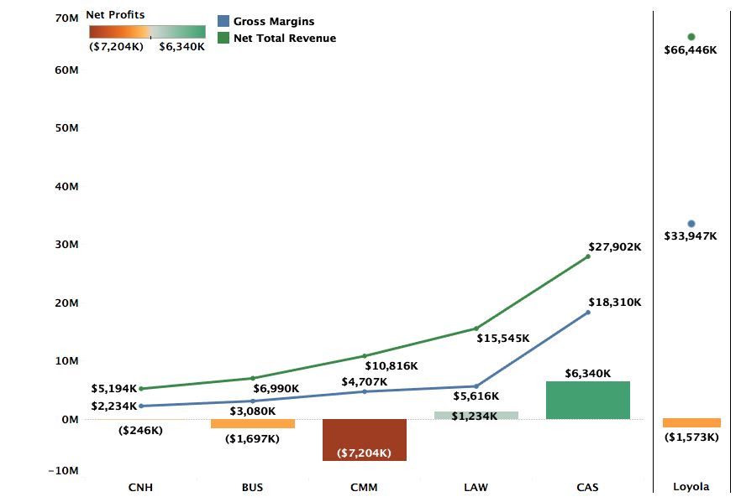
Profitability by College FY20 Actuals

Slide 26
Profitability by Department (FY20 Actuals)
Excluding Environment
Notes:
Departments like Teacher Certification and Studio art are small departments with low costs. They have +ve gross margins but higher profitability largely because of dorm revenue share which is divided by college and within college, the departments get equal share.

Slide 27
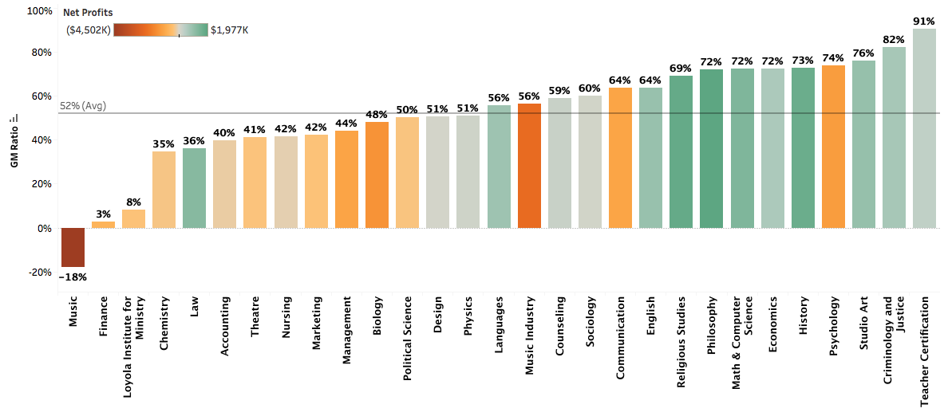
GM to Revenue Ratio by Department (FY20 Actuals)
Excluding Environment

Slide 28
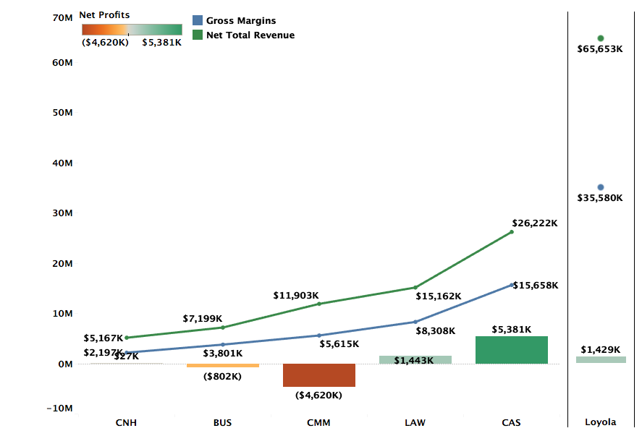
Profitability by College FY19 Actuals

Slide 29
Profitability by Department (FY19 Actuals)
Excluding Classical Studies and Environment
Notes:
Departments like Teacher Certification and Studio art are small departments with low costs. They have +ve gross margins but higher profitability largely because of dorm revenue share which is divided by college and within college, the departments get equal share.

Slide 30
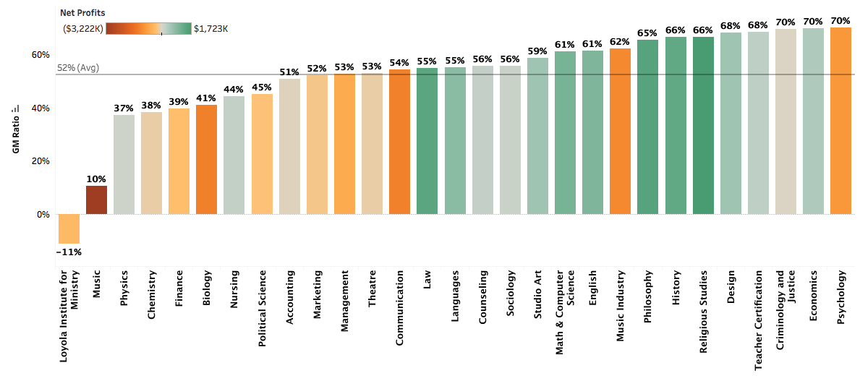
GM to Revenue Ratio by Department (FY19 Actuals)
Excluding Classical Studies and Environment

